Slide 1

MACHINE LEARNING
(24AD2204)
Lecture - 1
Introduction to Machine Learning: Human learning and its types, ML and its types and Well-Posed Learning Problem

Slide 2

Introduction
Course Title : | MACHINE LEARNING
Course Code : | 24AD2204
L-T-P-S Structure : | 3-0-2-0
Credits : | 4
Course Coordinator : | D. JYOTHSNA

Slide 3
MACHINE LEARNING(24AD2204)
syllabus
CO1: Introduction to Machine Learning: Human learning and its types, ML and its types, well-posed learning problem, applications of ML, issues in ML, Preparing to model: Basic data types, exploring numerical data, exploring categorical data, exploring relationship between variables, data quality and data remediation, data preprocessing.
CO2: Modeling and Evaluation: Selecting a model, training model – holdout, k-fold cross-validation, bootstrap sampling, model representation and interpretability – under-fitting, over-fitting, bias-variance tradeoff, model performance evaluation – classification, regression, clustering, performance improvement, Feature engineering: Feature construction, feature extraction, feature selection.
CO3: Brief review of probability: Basic concept of probability, random variables, discrete distributions – binomial, Poisson, Bernoulli, continuous distribution – uniform, normal, Laplace, central theorem, Monte Carlo approximation, Bayesian concept learning: Bayes theorem – prior and posterior probability, likelihood, concept learning, Bayesian Belief Network.
CO4: Supervised learning – Classification, k-Nearest neighbour, decision tree, random forest, support vector machine, Regression: Simple linear regression, Unsupervised learning: clustering techniques - partitioning methods, hierarchical methods, density-based methods, association rules, Basis of neural network: biological neuron and artificial neuron, types of activation functions, learning process in ANN, representation learning, active learning, instance-based learning, association rule learning, ensemble learning, ML live case studies.

Slide 4
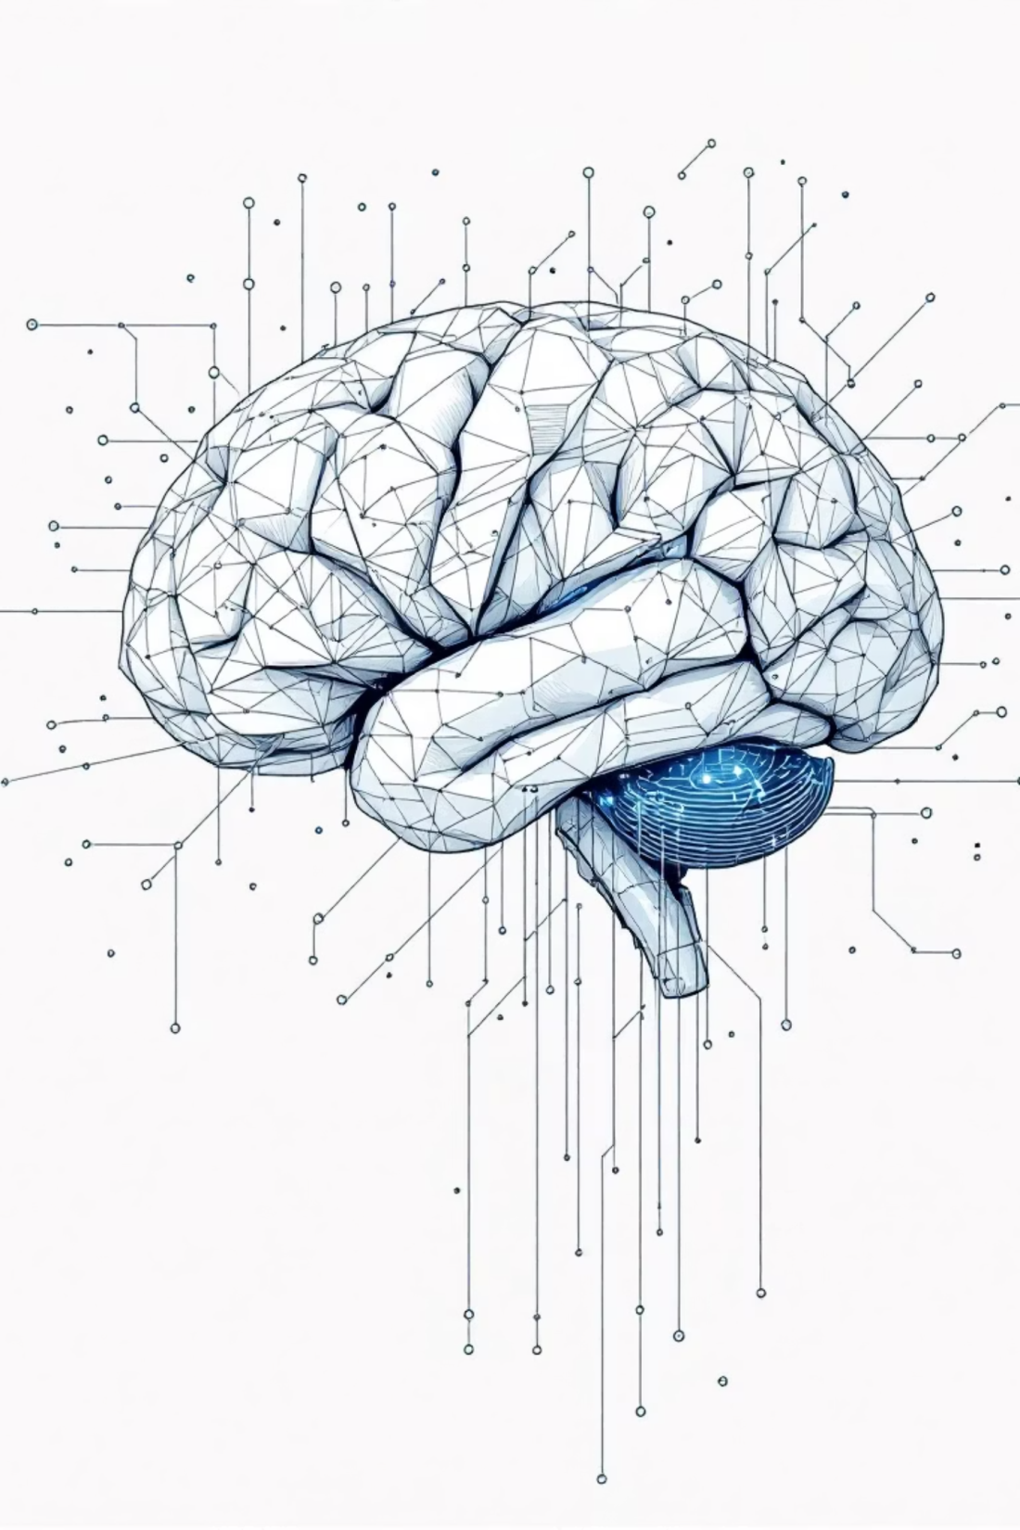
Introduction to Machine Learning
Machine learning has evolved from a niche computer science field into a transformative technology touching nearly every aspect of modern life. From defeating world chess champions to powering self-driving cars, ML represents humanity's quest to create intelligent machines that can learn and adapt.

Slide 5

Journey into Machine Learning
This chapter provides newcomers with a comprehensive starting point for understanding machine learning. We'll explore the historical evolution of ML, examine how machines learn compared to humans, and discover modern applications transforming our world.
You'll learn to identify problems suitable for ML solutions and understand the fundamental types of machine learning approaches used today.

Slide 6
The Historic Evolution of Machine Learning
1763-1913: Mathematical Foundations
1
Thomas Bayes's work on probability theory published posthumously (1763). Pierre-Simon Laplace formalized Bayes theorem (1812). Method of least squares established (1805). Andrey Markov introduced Markov chains (1913).
2
1950-1957: The Birth of ML
Alan Turing posed "Can machines think?" in his seminal paper (1950). Arthur Samuel developed first ML program playing Checkers (1952). Frank Rosenblatt designed first neural network simulating human brain (1957).
1967-1982: Pattern Recognition Era
3
Nearest neighbour algorithm created for basic pattern recognition (1967). Stanford students developed first self-driving cart (1979). Recurrent Neural Networks emerged (1982).
4
1989-1997: Commercialization Begins
Reinforcement Learning conceptualized and ML commercialization started (1989). Random Forest and Support Vector Machine algorithms developed (1995). IBM's Deep Blue defeated world chess champion Gary Kasparov (1997).
2006-Present: Deep Learning Revolution
5
Netflix launched first ML competition (2006). Geoffrey Hinton conceptualized Deep Learning (2006). Kaggle platform launched (2010). IBM's Watson won Jeopardy (2011). Google's AlphaGo beat professional Go player (2016).

Slide 7
Understanding Human Learning
In cognitive science, learning is the process of gaining information through observation. We learn to perform tasks more efficiently as we acquire more information. From simple activities like walking to complex tasks like rocket trajectory calculations, learning improves our performance through accumulated knowledge and experience.
Learning Under Expert Guidance
Learning from Past Knowledge
Self-Learning
Direct instruction from teachers, parents, and mentors who possess knowledge through experience. From infancy through professional careers, experts guide our learning journey.
Applying information taught in one context to make decisions in another. A child groups objects by color using knowledge previously shared by parents in different situations.
Learning through trial and error without direct instruction. Babies learning to walk, children riding bicycles, adults driving cars - forming checklists of dos and don'ts from experience.

Slide 8

What Is Machine Learning?
"A computer program is said to learn from experience E with respect to some class of tasks T and performance measure P, if its performance at tasks in T, as measured by P, improves with experience E."
— Tom M. Mitchell, Carnegie Mellon University
Machines learn by gathering experience through past data and improving performance on similar future tasks. In image classification, experience (E) is past labeled images, the task (T) is classifying new images, and performance (P) is the percentage correctly classified.

Slide 9




The Machine Learning Process
Data Input
Past data or information serves as the foundation for future decision-making. This historical data provides the experience machines need to learn.
Abstraction
Input data is represented broadly through underlying algorithms. The machine creates a conceptual model - a summarized knowledge representation of raw data.
Generalization
The abstracted representation forms a framework for making decisions on new, unseen data. The model is tuned to handle unknown characteristics.
Much like students who move beyond memorization to understand key concepts and apply them broadly, machines abstract patterns from training data and generalize to make predictions on new data.

Slide 10

Defining a Well-Posed Learning Problem
What is the Problem?
Why Solve This Problem?
How to Solve the Problem?
Provide informal and formal descriptions. Use Mitchell's formalism to define Task (T), Experience (E), and Performance (P). List assumptions and identify similar problems.
Articulate motivation and requirements. Consider solution benefits and capabilities it enables. Determine how the solution will be used and its expected lifetime.
Explore manual solution approaches. Detail step-by-step data collection, preparation, and program design. Update assumptions based on this exploration.
Example: For a word prediction program - Task: Prompt next word when typing. Experience: Corpus of common English words and phrases. Performance: Percentage of correct word prompts (learning accuracy).

Slide 11
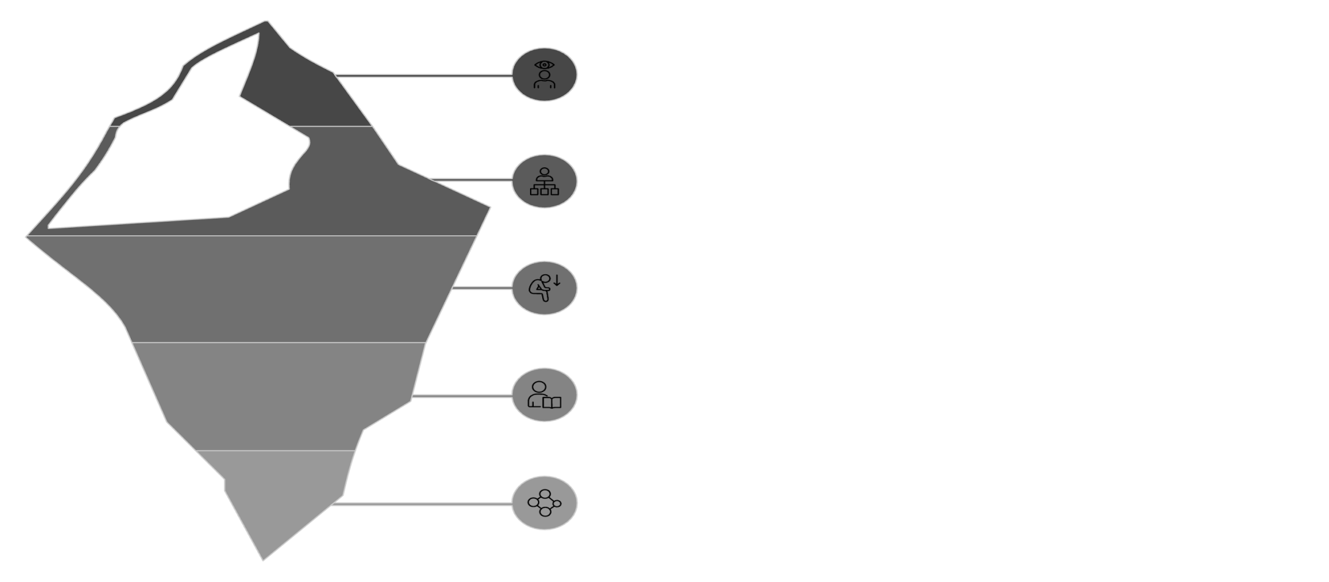





Types of Machine Learning
Supervised
Classification
Regression
Unsupervised
Clustering
Supervised Learning
Unsupervised Learning
Reinforcement Learning
Predictive learning where machines predict classes of unknown objects based on labeled training data. Includes classification (categorical prediction) and regression (numerical prediction).
Descriptive learning where machines find patterns by grouping similar objects without labels. Includes clustering and association analysis.
Machines learn to act autonomously to achieve goals through reward and punishment feedback, improving performance over time.

Slide 12
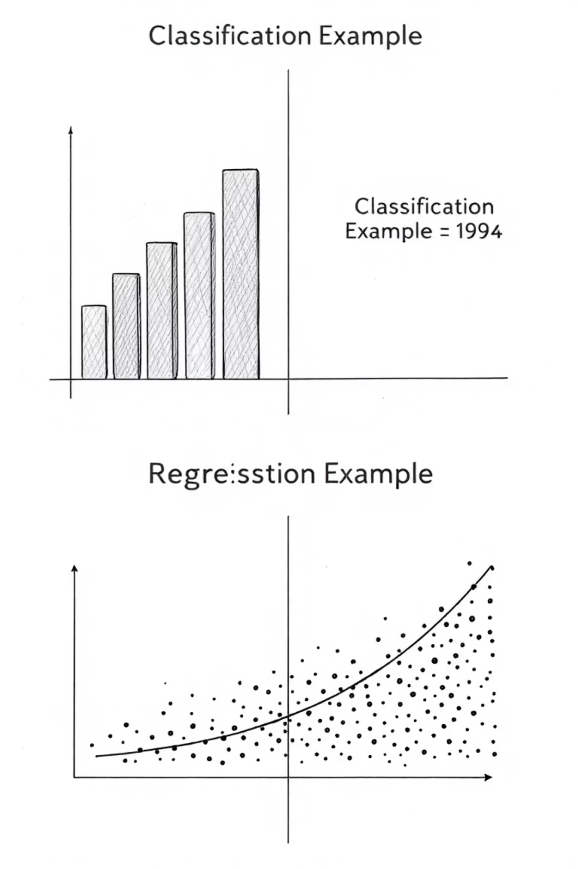

Supervised Learning in Action
Classification Problems
Predicting categorical variables - which class does data belong to? Training data contains labeled examples. Machine maps new data to similar training examples and assigns the same label.
Fraud detection in banking transactions
Image classification and recognition
Disease prediction from symptoms
Email spam filtering
Handwriting recognition
Regression Problems
Predicting continuous numerical values. A mathematical relationship is fitted between predictor and target variables using methods like least squares.
Real estate price prediction
Stock market forecasting
Sales revenue prediction
Weather forecasting
Demand forecasting in retail
Key Insight: Supervised learning quality depends entirely on training data quality. Poor training data leads to imprecise predictions.

Slide 13
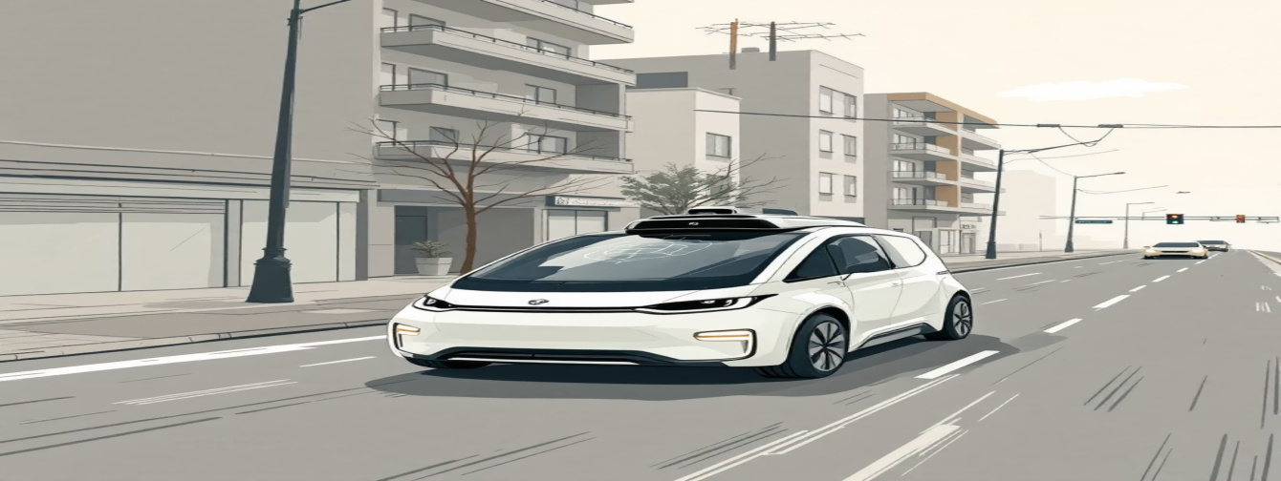

Unsupervised & Reinforcement Learning
Unsupervised Learning
Reinforcement Learning
Discovers natural groupings in unlabeled data through pattern recognition. Clustering groups similar objects using distance measures. Association analysis identifies relationships between data elements.
Agents learn through trial and error, receiving rewards for correct actions and punishment for mistakes. The model continuously updates itself to maximize rewards.
Applications: Self-driving cars, intelligent robots, AlphaGo, personalized marketing.
Applications: Customer segmentation, market basket analysis, recommender systems.
52%
Deep Blue's Power
Go's Ancient History
200M
2500
Cancer Detection
ML can spot breast cancer cells a year before diagnosis
Positions searched per second vs. Kasparov's 5-10
Years since Go was invented in China

Slide 14
SUMMARY

Slide 15

THANK YOU!

